Slide 1
O&G in a nutshell
Dr Laura Lee

Slide 2
Obstetric terminology
Gravidity
Parity
Gestation
PROM
SROM
PPROM
APH/PPH
GDM
PIH/Gestational Hypertension
Stages of labour

Slide 3
CTG basics
D Define Risks
R Risks
C Contractions
B Baseline
Ra Rate
V Variability
A Acceleration
D Decelerations
O Overall

Slide 4
Define Risks
Antenatal conditions
Intrapartum conditions
Clinical History

Slide 5
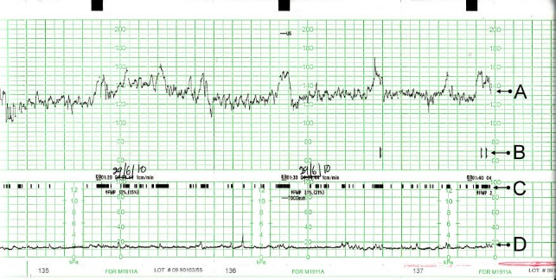
Contractions
CTG – Cardio TOCO graph

Slide 6
Contractions
Tachysystole
>5 active labour contractions over a ten mins period
Uterine Hypertonus
Contraction lasting more than 2 mins or occurring within 60 secs of each other
Uterine hyperstimulation
Tachysystole and uterine hypertonus with fetal heart rate abnormalities

Slide 7
Tachysystole

Slide 8
Hypertonus

Slide 9
Uterine hyperstimulation

Slide 10
Baseline Rate
Normal rate
110-160
Between contractions with no fetal activity
Sympathetic vs Parasympathetic
Without a baseline unable to comment on any other features
Influence of medication

Slide 11
Baseline Rate

Slide 12
Baseline bradycardia

Slide 13
Baseline bradycardia

Slide 14
Baseline bradycardia

Slide 15
Baseline tachycardia

Slide 16
Baseline tachycardia

Slide 17
Baseline Bradycardia causes
Low inherent rate (maturity)
Maternal hypotension (reduced cardiac output)
Prolonged cord compression
Fetal hypoxia
Fetal heart rate conduction defects
Medication (B Blockers)

Slide 18
Baseline tachycardia causes
Maternal fever
Localised fetal infection
Prematurity
Hypoxia
Medication (Eg salbutamol, terbutaline)
Fetal tachyarrhythymias

Slide 19
Decelerations
Early Decelerations
Variable Decelerations
Prolonged Decelerations
Late decelerations
Others

Slide 20
Early decelerations

Slide 21
Early decelerations

Slide 22
Early decelerations
Benign
Responds to increased intracranial pressure
Uncommon
Happens in clusters often with associated reduced fetal baseline heart rate
Commences and ends with contract5ion

Slide 23
Variable Decelerations

Slide 24
Variable deceleration
Common deceleration
Caused by cord compression
Vary in length, depth, duration, and riming

Slide 25
Variable Deceleration- complicated
Depends on overall clinical picture
Associated with
Rising baseline/Tachycardia
Reduced baseline variability
Persistent large amplitude(>60BPM)/ long duration (>60secs)
Loss of pre and post deceleration shouldering
Presence of smooth post-decelerations overshoot
Slow return to baseline FHR

Slide 26
Rising baseline

Slide 27
Overshoot

Slide 28
Slow return to baseline

Slide 29
Prolonged deceleration
More than 90 seconds; Less than 5 moniutes

Slide 30
Late decelerations
Hypoxia
Happens with every contraction
Uniform and repetitive
Happens after the start of the contraction and nadir typically after the peak of the contraction

Slide 31
Late deceleration

Slide 32
Sinusoidal trace

Slide 33
Sinusoidal trace
Oscillating pattern
Smooth and irregular
2-5 cycles
Absent baseline variability
Reflective of severe anaemia (Hb <50)
Presents also with reduced fetal movement

Slide 34
Pseudosinosoidal trace

Slide 35
Pseudosinusoidal trace
Not as smooth or as regular as a sinusoidal trace
Prior and subsequent normal trace
Not associated with fetal compromise

Slide 36
Fetal Arrhythmias

Slide 37
Fetal Arrhythmias

Slide 38
Fetal arrhythmias
Irregular heartbeat ie with atrial or ventricular ectopics
Often disappear after birth
Often heard
Cardiac USS performed to ensure no structural abnormalities

Slide 39
Instrumental deliveries
Indications
Methods
Ventouse
Forceps
Outlet
Neville Barnes
Rotational

